Slide 1
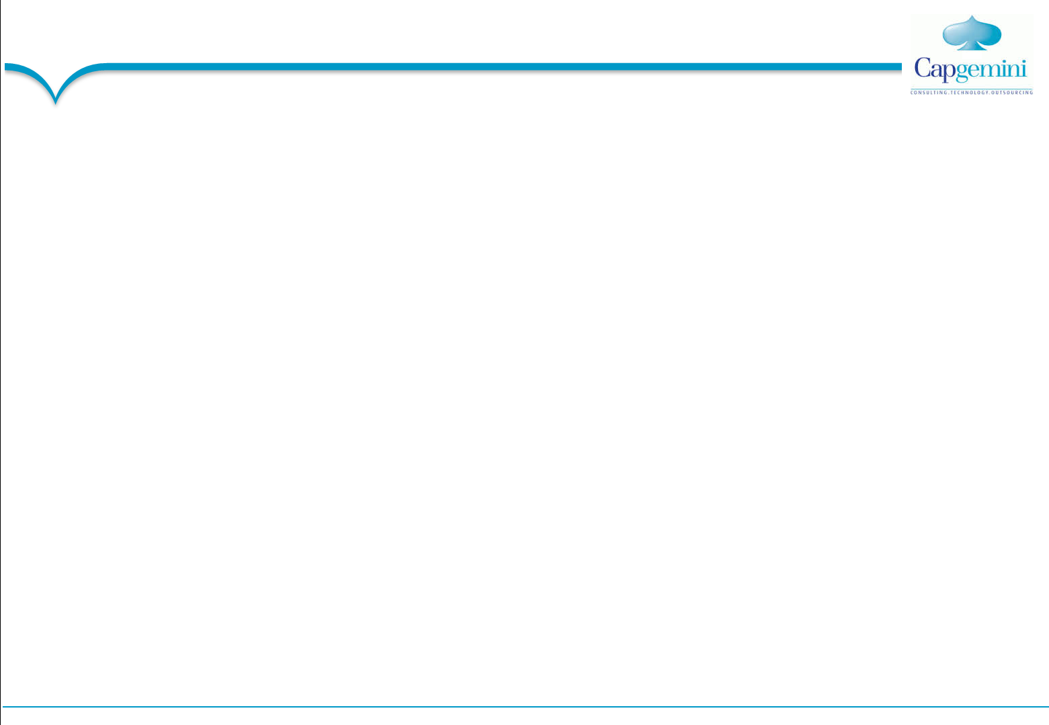
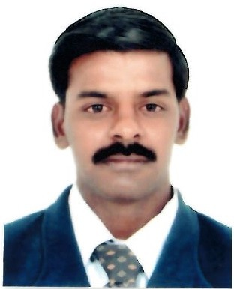

Balakrishna Chitoor Gajendran – Technical Manager CRM & SCM
Professional Background
14+ years of overall experience out of which 8.5 Years of experience in Maintenance & Development and 6 Years of experience in Agile based Development
Global Work Experience - Worked in Sweden, Germany, Netherland
An effective communicator with strong leadership, people management, analytical and problem solving skills. At equal ease in interacting with people across hierarchical levels in an organization for ensuring smooth task execution
Education/Certifications
Master of Science in Computers
ITIL V3 Foundation
SCJP 1.6
Scrum Master Accredited Certification from International Scrum Institute™
Past Clients
Alcatel-Lucent
General Motors
IKEA
Daimler
Canon
Areas of Expertise
Domain Expert
Agile Based Development
Project Management
Technical Expertise in Java Based applications
Service Level Management
Industry Expertise
Automobile
Retail
CRM
SCM
Experience & Accomplishments
Handling end to end service delivery for Telecom , Automobile & Retail Applications - Driven 40% incident reduction and Zero Severity 1 incidents by delivering very effective Service Level management
Platform availability is maintained at Green level by implementing very robust monitoring and review mechanism
Practiced quality management system such as Lean, Kazan and Six Sigma methodologies to deliver business value
Consistently achieved service level agreements and Key Performance Indicators through operations transformation and automation initiatives
Played Domain Expert role for Automobile & Retail platforms covering end to end transaction flow
Experienced on Agile Methodology, Function Point Analysis and Estimation Techniques
Experienced in Application Analysis tool CAST and Log Analysis Tool SPLUNK.

